Slide 1



Slide 2
Start a new journey!
Become a software developer!

Slide 3
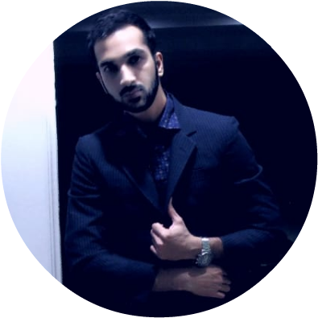
About Me
Khurram Raheel (MCP)
Microsoft Certified Developer
IBM Certified Blockchain Developer
Fintech Foundation Environment
Creative Programming in Digital Media

Slide 4
Khurram Raheel
Trainer at Gamicacloud
Artificial Intelligence
Cloud Computing

Slide 5

Khurram Raheel
COO GM. Capital Investments

Slide 6
Khurram Raheel
LEAD Gamica Tutors www.gamicatutors.com
Online and Onsite tutors provider

Slide 7
Khurram Raheel
LEAD Gamica Studios www.gamicastudio.com
Video production, graphics designing

Slide 8
What to choose as IT field?
Software developer (Cloud, Mobile apps etc)
Networking expert
Cyber security
Design and branding

Slide 9
Why software development?
The highest-paid in the profession earned $119,550, while the lowest-paid earned $35,390
Convert to Pakistan Rupee
Maximum>
$119,550 * 100 = 11,955,000 (Annually) (11,955,000 / 12 ) = 996,250Rs. (Monthly)
Minimum>
$35,390 * 100 = 3,539,000(Annually) (3,539,000 / 12 ) = 294,916Rs. (Monthly)

Slide 10
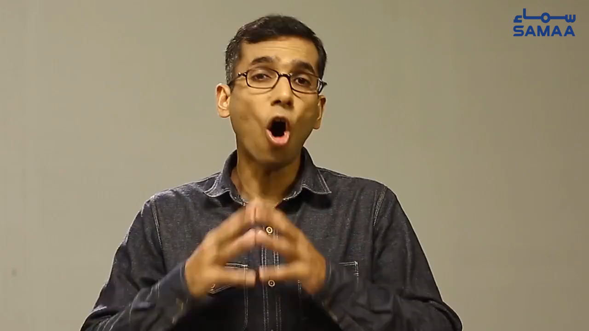

Slide 11


New to programming?
sadsad
Are you be willing to join us for regular
study and learning?

Slide 12
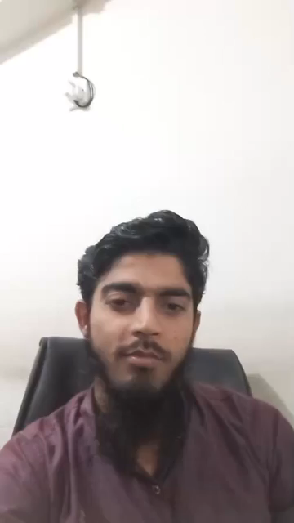

Slide 13
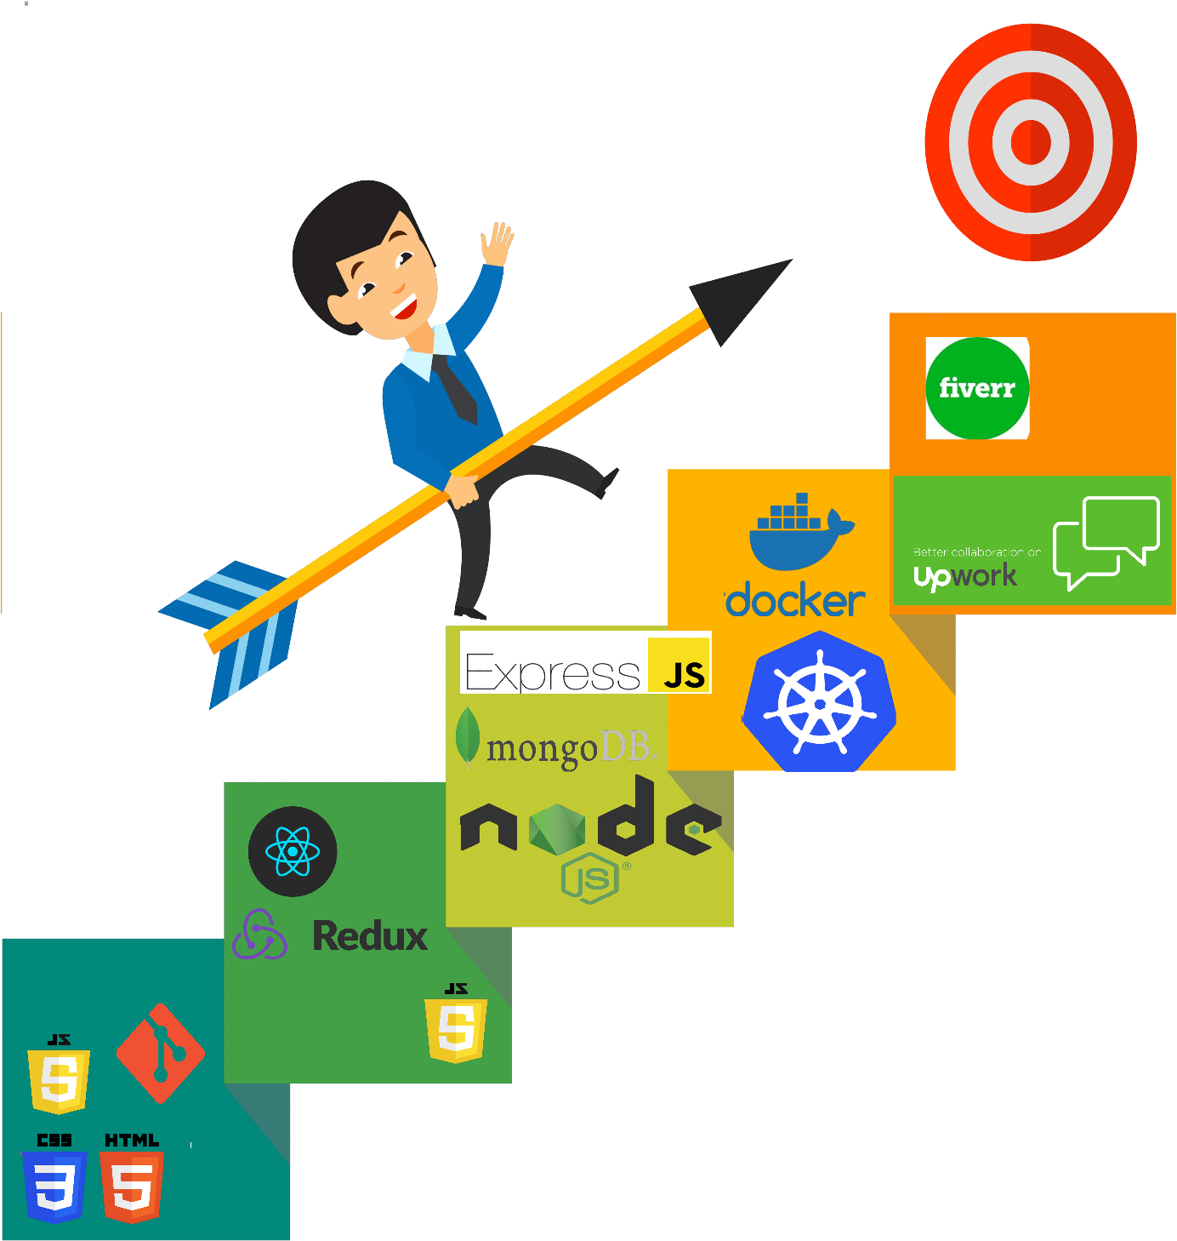
Learning path

Slide 14

Learning path
Panacloud’s Internships
A 3 months intensive training on upcoming technologies in 2021
Typescript
GraphQL
AWS Cloud Services
Contentful API
Jamstack
FaunaDB/DynamoDB

Slide 15
Freelancer partnership program
Contract based working with the organization.
Gamica provide the IT infrastructure, Space, Environment (AC), Technical Supervision.
Freelancers can smoothly work on their projects without hassle.
Run-time troubleshooting and architectural support.

Slide 16

Yes?
Be consistent
Always be in the class
DO homework
Always discuss your queries with your teachers and seniors
Be Punctual

Slide 17
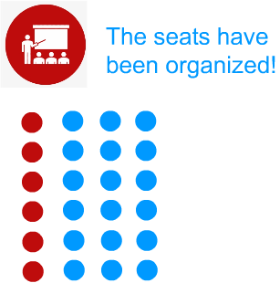
Newbies
Stable ones

Slide 18

Questions?

Slide 19
Tools we needed

Slide 20
Thank You

